Slide 1
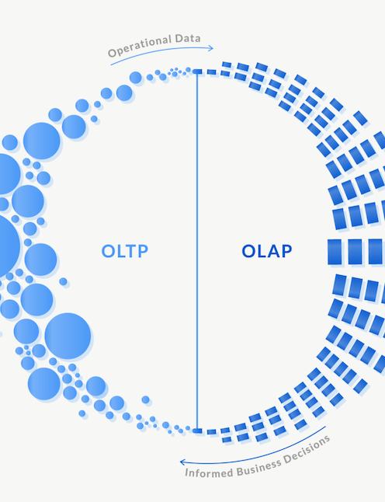
Project 3 & 4 Administration
OLTP to OLAP

Slide 2
Source Dataset
applicant_id applicant_name
applicant_gender applicant_dob applicant_country applicant_qual_test_score applicant_high_school_GPA scholarship_grade
scholarship_pct interview_date interview_score admission_date institute_id course_name
Education Data
Format: CSV
No. of files: 19
Total size: 1.3 GB
institute_id institute_name institute_fee
institute_reputation institute_campus_job_placement_pct
institute_campus_area score_cut_off
total_no_of_students applied_no_of_students declined_no_of_student_pct accepted_no_of_student_pct
Applicant Data
Institute Data
2
www.3aayaam.in

Slide 3
Administration
Create 2 tables – Applicant and Institute, with the following properties
Applicant Table – DistKey: applicant_id, SortKey: applicant_id, DistStyle: EVEN, PrimaryKey: applicant_id, ForeignKey: institute_id
Institute Table - DistKey: institute_id, SortKey: institute_id, DistStyle: KEY, PrimaryKey: institute_id
Load each applicant file 4 times into the Applicant table. Put all files in one and then load again. Is there any difference in execution time.
Check the following:
What is the size of individual tables.
What is the slice distribution per node. How many blocks are there per slice.
Find DISTKEY, SORTKEY and DISTSTYLE of each table.
Find if column encodings have been applied in the tables.
3
www.3aayaam.in

Slide 4
Administration - observation
You realize after a few weeks that most of the queries have the following patterns (priority is given along with the statements):
Find all applicants that have been placed in individual institutes. P1
Find information about individual applicants/students. P1
No. of students per institute. P2
Details of an institute, which are queried by students/applicants. P2
All students that have been declined from an institute. P3
Age, country and qualification score of individual applicants. P4
Reputation of an institute along with its score cut off. P5
All applicants with interview score more than certain percentage. P5
Which institutes have the highest decline percentage. P5
4
www.3aayaam.in

Slide 5
Administration
Based on the query patterns in the previous slide, please do the following, if applicable:
Should DistKey and SortKey should be same for both the tables. If not then modify them.
What should be the primary key. Modify if necessary.
Can interleaved sort key be leveraged in any of the cases.
Please check if there are duplicate rows. If yes, delete or remove all duplicate rows in applicant table.
Check the size of the table before and after removing duplicate rows. Fix it if necessary.
Pls check how many times the tables were loaded. Were there any errors.
5
www.3aayaam.in

Slide 6
Administration
Create Orders table and load using large orders files. Check the status of load every 2 mins.
Split orders files into a total of 20 files and put them in separate S3 locations. Load them using manifest files.
Unload orders that are older than 2 years and delete them from the table. Keep the older records in S3.
6
www.3aayaam.in

Slide 7
OLTP to OLAP
There’s an OLTP database in Aurora MySQL, where applicant data is loaded on a regular basis.
Load the applicant files one-by-one every 5 mins. But the records should be automatically be loaded to Redshift from Aurora.
2 options to load data from OLTP to OLAP. Use any one or both.
Zero ETL
AWS DMS
7
www.3aayaam.in

Slide 8
OLTP to OLAP
File 1
OLTP Aurora MySQL Database
OLAP Redshift Data Warehouse
DMS
File 2
Zero-ETL
File 3
File 4
8
www.3aayaam.in

Slide 9
Thank you
www.3aayaam.in

